Slide 1


Data
Analysis
Notes:
Hello and welcome, my name is Shradha Pujari and today I will be presenting to you the results of the Data Analytics task.

Slide 2


Today's agenda
Project recap
Problem
The Analytics team
Process
Insights
Summary
Notes:
The following items will be on today's agenda:
We will summarize the overall project to provide a high-level overview of the business problem and the specific requirements.
We will go over the exact topic that we, the Data Analytics team, have been working on and explain why it is such a major deal.Following the introduction of the problem, I will go over the team's responsibility from our end for completing this assignment.
I will then go into the high-level process that we used to finish this assignment so that you understand exactly how we approach this kind of task.
Finally, I will go over the most relevant findings and offer them as a series of insights and visualizations based on our investigation.
To conclude, I will summarize and leave the floor open for questions..

Slide 3


Project Recap
Social Buzz is a rapidly rising technology unicorn that must quickly adjust to its worldwide scope. Accenture has initiated a three-month proof-of-concept focusing on the following tasks:
An examination of Social Buzz's big data strategy
Suggestions for a Successful IPO.
Research to determine the top five most popular content categories on Social Buzz
Notes:
Let me begin by recapping this engagement.
Accenture has begun a three-month trial with Social Buzz to focus on three primary tasks that are linked with some of the most pressing difficulties you are now facing.
In recent years, Social Buzz has grown to become known as a global unicorn firm. We are here to assist you in navigating this scale and pointing you in the proper route.
To begin, we will audit your big data approach and share best practices and industry knowledge. Second, we will guide you through a successful IPO, in which we have extensive expertise and knowledge.
Finally, we analyzed your data to get insights into your top five most popular content categories.

Slide 4


Problem
- Every day, about 100,000 posts are made.
- Every year, 36,500,000 pieces of material are created!
- Yet the ways can you leverage the opportunity when there's so much of it?
- An examination of the top five most popular content categories on Social Buzz
Notes:
Focusing on the last item I said, this is what the Data Analytics team has been concentrating on.
Obviously, with such grandiose scale comes a lot of data, and with such large volumes of data comes issues.
To give you an idea of how much data you've been producing: -
You told us that your platform receives over 100,000 posts each day, for a total of 36,500,000 posts per year, all of which is unstructured data that is difficult to understand.
In this day and age, content reigns supreme. Consider some of the world's largest platforms, such as YouTube, Facebook, and Netflix... they are all content businesses...
Yet the manner in which do you capitalize on it when there's an abundance of it?This is not only a matter of gathering as much content as possible...
The true value comes from analyzing and processing this content in order to obtain a deeper understanding of your audience and hence create a more tailored and entertaining experience.
In addition this is where our data analytics experience comes in; using the insights gained from this assignment, we can show you exactly how to grow analytics.

Slide 5



ANDREW FLEMING
Chief Technology Architect
The Analytics team
MARCUS ROMPTON
Senior Principal
Shradha Pujari
Data Analyst
Notes:
In terms of experience, Accenture has a significant data analytics group, but we only had a team of three employees primarily focused on this assignment.
Our Chief Technical Architect, Andrew Fleming, was instrumental in guiding the team to provide high-quality analysis.
Marcus Rompton, a senior principal, has solved data problems for some of the world's largest companies and was actively involved in the data engineering side of this project.
Finally, Shradha was exclusively accountable for taking leadership direction and generating high-quality insights from raw datasets, which were then translated into business choices.

Slide 6

Process
1
Data Understanding
2
Data Cleaning
3
Data Modelling
4
Data Analysis
5
Uncover Insights
Notes:
So, how did we approach this issue?
We addressed it in five steps:
Data comprehension - Understanding the data in depth is critical to the success of any data endeavor. As a result, we spent time learning about your company's data model and domain.
Data cleansing - After learning about your company, we cleaned the available datasets and considered what an ideal dataset would look like for this situation.
Data modeling - Once the data was clean for analysis, we needed to process and model it into a dataset that could correctly answer the business questions and produce the required outcomes.
Data analysis We then leveraged our analytical capabilities to identify insights from our new dataset and to create visualizations to describe the insights.
In the end, we applied these insights to create business decisions and recommendations for the next steps.

Slide 7


Insights
16
UNIQUE
CATEGORIES
1897
REACTIONS TO
"ANIMAL" POSTS
JANUARY
MONTH WITH
MOST POSTS
Notes:
We discovered that you had a total of 16 distinct types of posts across your sample dataset based on your data. This encompasses topics like food, culture, and sports.
In addition, there were 1897 reactions from the animal category alone! People certainly adore animals!
In addition, January was the most popular month for people to publish. This corresponds to seasonal trends among social media users who feel the desire to reconnect with people following calendar occasions such as Christmas.
But now for the major question... what were the top five most popular article categories?

Slide 8
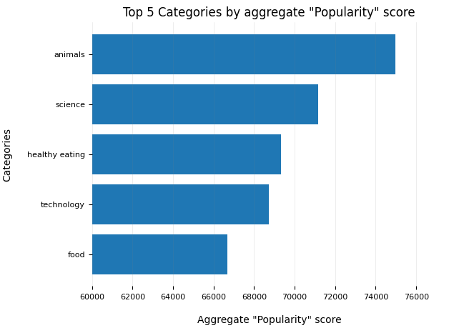
Notes:
According to our findings, the top five most popular categories of posts were, in descending order, animals, science, healthy eating, technology, and food.
Animals got a total popularity score of about 74965. It's fascinating to see both food and healthy eating in the top 5, demonstrating that food is a very engaging content topic.
Because healthy eating scores slightly higher than food, your user base may be skewed toward healthy eaters and health-conscious individuals.
Finally, it's fascinating to witness science and technology.
This could imply that consumers prefer absorbing factual content and pieces of content from which they can learn something.

Slide 9
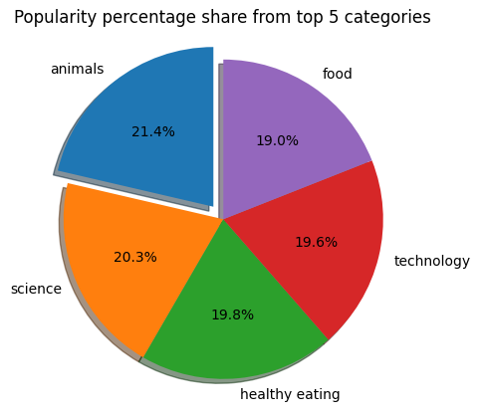
Notes:
This figure also shows the percentage split of popularity among the top five categories.
There is not much difference in the percentage of each category, but the difference between the first most popular, animals, and the second most popular, science, is the largest, accounting for 1.1% of the total.
In business words, this could imply that the most popular category, animals, is lagging behind the others and may continue to grow in popularity.
To avoid a situation in which one content category absorbs the entire platform, you must guarantee that any algorithms used to manage the content on the platform provide a proper balance to the content categories.

Slide 10


Analysis:
Animals and science are the two most popular content categories, indicating that consumers prefer "real-life" and "factual" information.
Insights:
Food is a recurring topic in the top five categories, with "Healthy Eating" rating highest. This may provide an insight to your user base's audience. You might utilize this information to develop a campaign and collaborate with healthy eating brands to increase user engagement.
Summary
Next Step:
This ad hoc analysis is useful, but it's time to put it into large-scale production for real-time understanding of your business. We can demonstrate how to accomplish this.
Notes:
In a nutshell:
We embarked on this work and discovered the top five most popular categories, as requested, but we went one step further.
- We discovered that the two most popular categories are animals and science, implying that consumers prefer "real-life" and "factual" information.
We also discovered that food was a common topic across popular material, with healthy eating being the most popular food category.
This could be a signal indicating the types of people who use your platform, and you could use this information to increase interaction even more.
You may, for example, run a campaign with content centered on this area or collaborate with healthy eating brands to promote content.
- As insightful as this study was, we are ready to take it to the next level, and Accenture has the knowledge to help you realize these kinds of insights in production across your business and in real-time. We would be delighted to assist you with this.

Slide 11

Thank you!
ANY QUESTIONS?
Notes:
Thank you for taking the time to listen;
Please feel free to ask any questions you may have!

